Slide 1
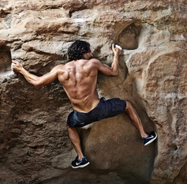
STRENGTH TRAINING for ROCK CLIMBERS https://www.youtube.com/watch?v=l_lZc7nATT4

Slide 2
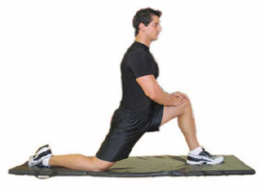
STRETCHING
FROG STRETCH
HIP-FLEXOR STRETCH
Do each stretch before workout, 5 sets 30sec each

Slide 3
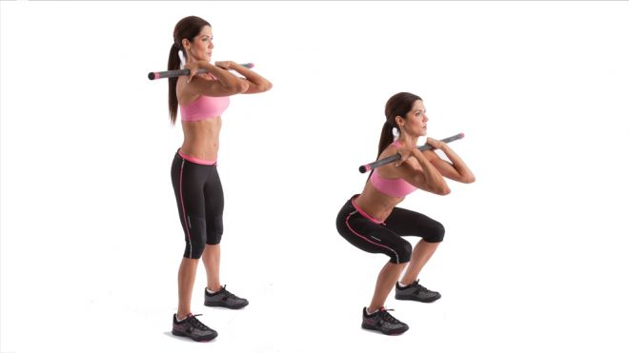
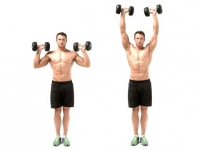
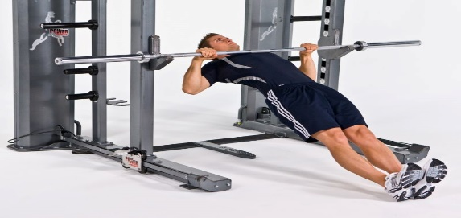
FUNCTIONAL LIFTS
Front Squats
Military Press
Inverted Row
Perform each exercise 5 sets x 10 reps each, 3x week

Slide 4
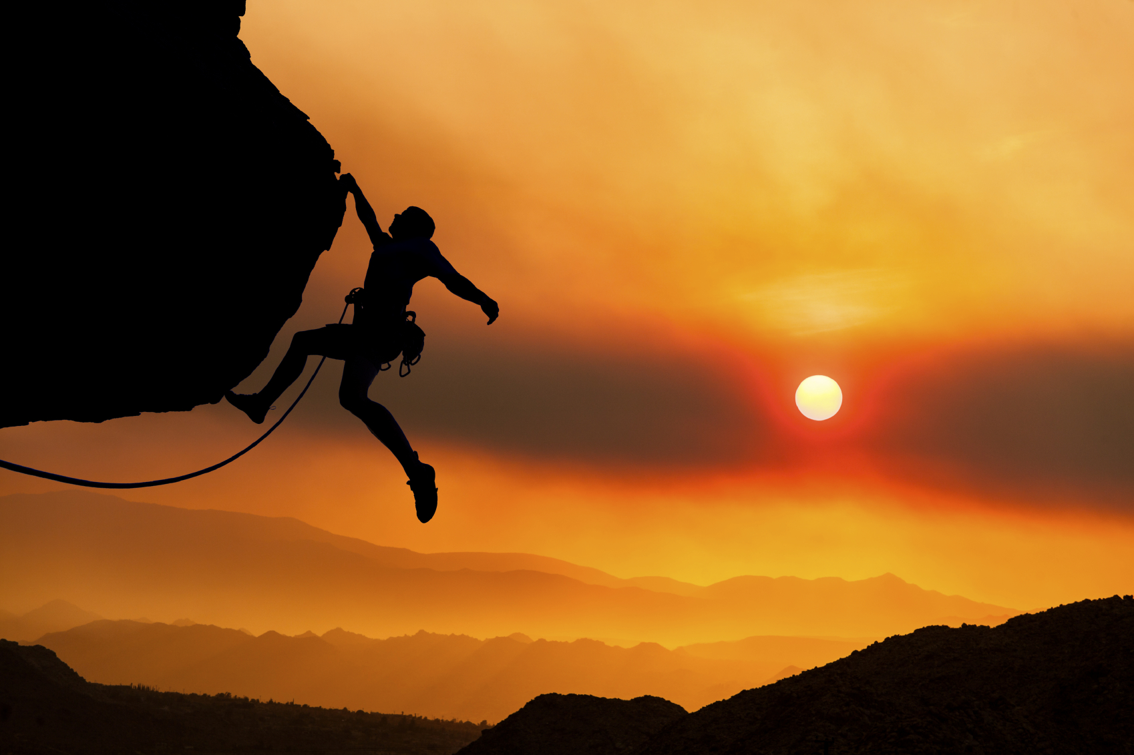
TYPES OF CLIMBING
4 Types
Top-Rope Climbing
Sport Climbing
Traditional Climbing
Bouldering

Slide 5
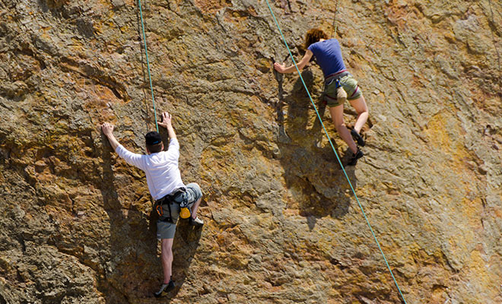
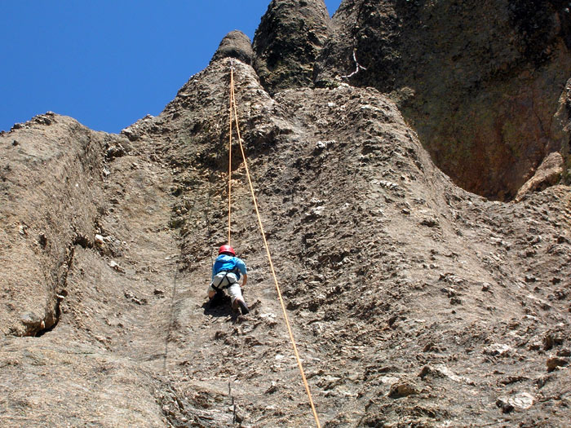
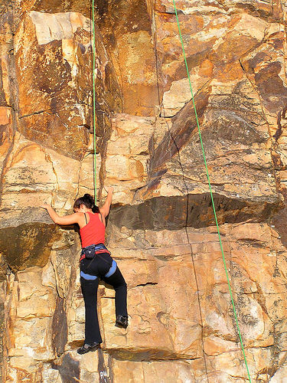
TOP-ROPE CLIMBING
-Climbing with the rope anchored above so you're always protected and never at risk when taking a fall.
-Top-roping is the safest way to climb outside for beginners, requires only basic equipment
Top-rope climbing areas are found anywhere there are cliffs

Slide 6
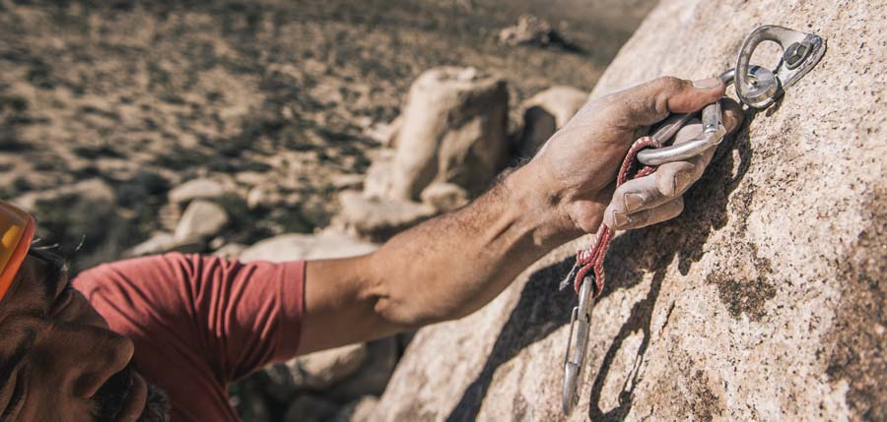
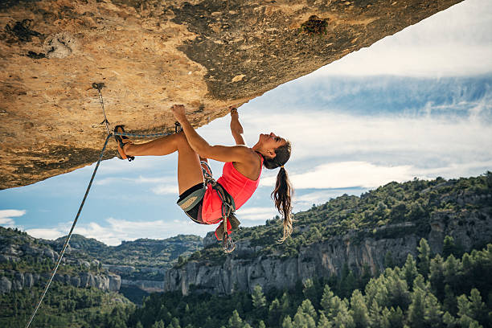
SPORT CLIMBING
Sport Climbing-is ascending cliffs usually 100 ft high that are protected with pre-placed bolts that are left in the rock.

Slide 7
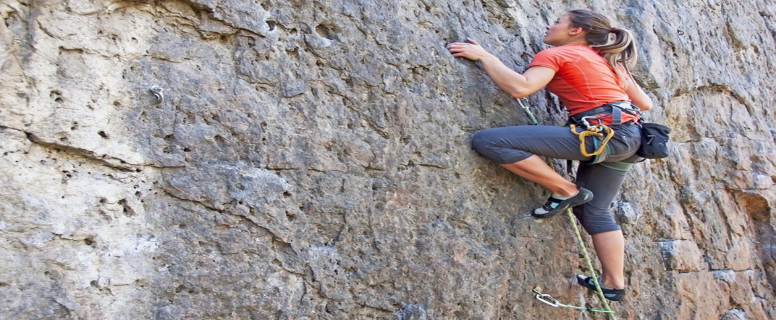
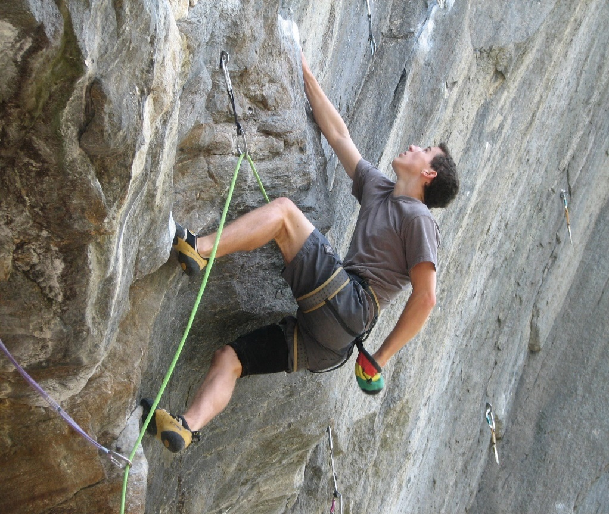
SPORT CLIMBING
Sport climbing is about pushing your limits and using gymnastic moves, most sport routes are safe, you can climb without a lot of risk, found everywhere

Slide 8
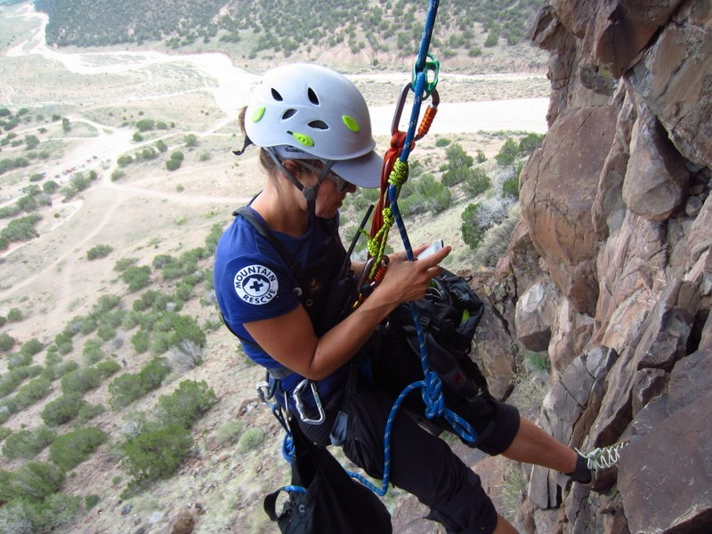
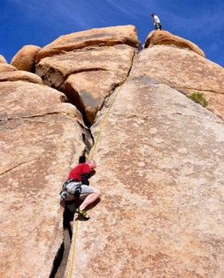
TRADITIONAL CLIMBING
Traditional Climbing-is when a climber places removable gear including cams and nuts as they climb.
A climber needs to have trad skills to climb safely. Most trad climbers ascend crack systems that lead, climber wedges gear into for protection
Traditional climbing offers real adventure up high cliffs.

Slide 9
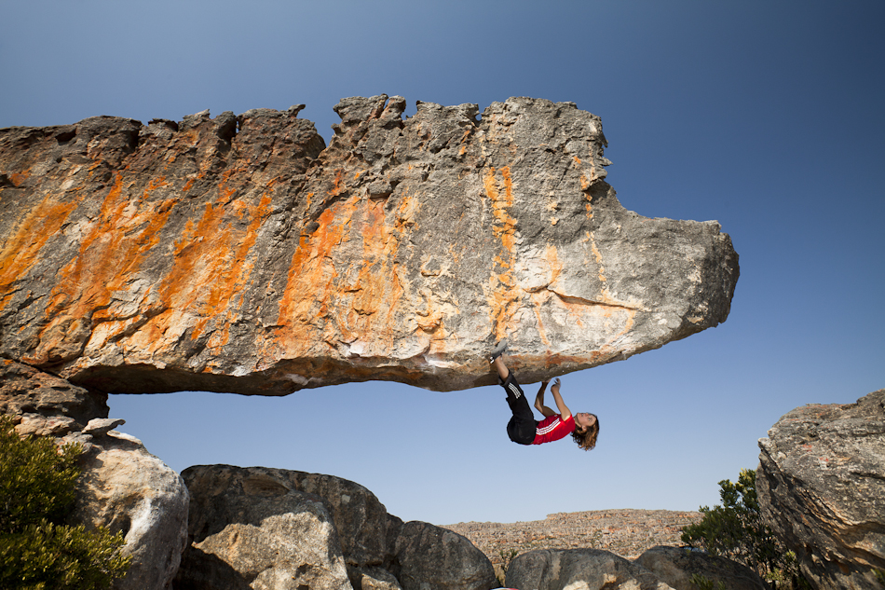
BOULDERING
Bouldering-climbing on blocks of rock or small fences without a rope, harness or gear.

Slide 10
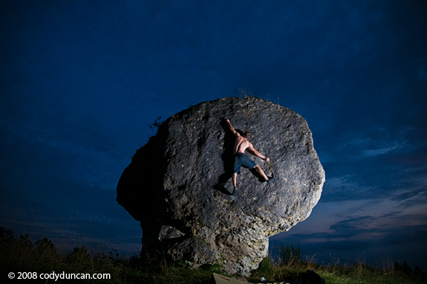
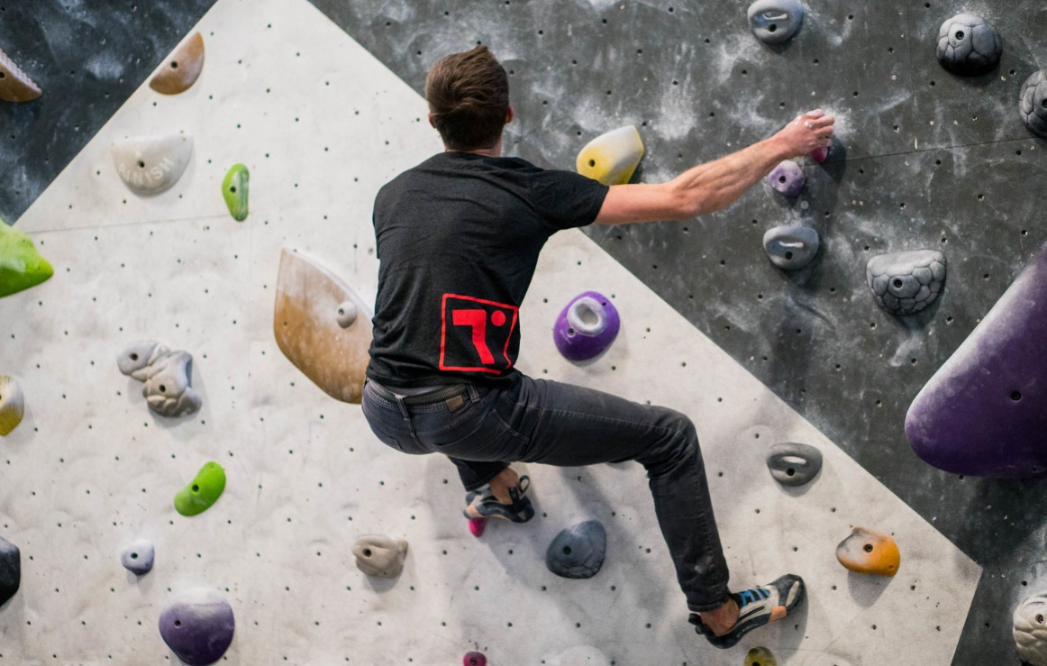
BOULDERING
Bouldering is good training, makes you stronger and enables you to practice climbing moves safely just above the ground.
Requires only personal gear; rock shoes, chalk, chalk bag and a crash pad for cushioning landings.

Slide 11
GROUP DISCUSSION
1.WHAT ARE THE ADVANTAGES/DISADVANTAGES OF EACH TYPE OF ROCK CLIMBING?
2.What is your favorite type of rock climbing and why?
Top-Rope Climbing
Sport Climbing
Traditional Climbing
Bouldering

Slide 12
Basic Equipment List
Gym and Competition Harnesses
These thin specialized harnesses are used for hard sport routes, gym training, and competition climbing where light weight and free movement is essential. They have narrow leg loops and waist band; just enough padding for falls, hangdogging, and belaying; and are very lightweight. They are generally uncomfortable for most general climbing. Prices for sport harnesses range from $50 to $125.
https://www.thoughtco.com/which-climbing-harness-do-you-need-755656

Slide 13
Basic Equipment List
All Around or Multi-Purpose Harnesses
Multi-purpose harnesses are exactly that—harnesses for all kinds of climbing, including crack climbing and multi-pitch routes. These are ideal if you’re just starting out climbing as well as if you’re an experienced climber. They come in a wide variety of styles to fit all kinds of body types as well as budgets. Almost all of them feature padded leg loops and padded waist belt; detachable leg loops so you can answer’s nature’s call without taking it off; either two or four gear loops for racking carabiners, quickdraws, and gear on the waist belt; and a sewn dedicated belay/rappel loop on the front, connecting the waist belt and leg loops and allowing you to belay or rappel from it. Prices for all-around harnesses range from $50 to $150.
https://www.thoughtco.com/which-climbing-harness-do-you-need-755656

Slide 14
Basic Equipment List
Big Wall Harnesses
Big wall harnesses are big beefy harnesses intended for climbing multi-pitch routes on big walls that might take several days. Comfort on these long steep walls is very important so these harnesses have thickly padded waist belts and leg loops, which relieve pressure on the climber’s upper legs and waist when they are at hanging belays or standing in aiders while aid climbing. Big wall harnesses also have multiple gear loops so lots of equipment can be racked on them, as well as a sewn haul loop on the back of the waist belt and a thick sewn belay loop on the front. Prices range from $75 to $200.
https://www.thoughtco.com/which-climbing-harness-do-you-need-755656

Slide 15
Basic Equipment List
Alpine Harnesses
Alpine harnesses, designed for mountaineering, are lightweight bare-bones harnesses that are easily adjustable so they fit over a variety of bulky clothes since alpinists often change layers of clothes for different weather conditions. Leg loops are usually easily detached for bathroom breaks or to change pants. Look for ones with a padded waist belt for extra comfort. They are also constructed from durable water-repellent nylon so they can handle all kinds of wet and snowy mountain conditions. Alpine harnesses make a good beginner harness or an extra harness to bring to the crags for a friend since they are adjustable for various body types. These no-frills harnesses are inexpensive. Expect to pay around $50 for a good one.
https://www.thoughtco.com/which-climbing-harness-do-you-need-755656

Slide 16
Basic Equipment List
Chest and Body Harnesses
Chest and body harnesses are harnesses that either accompany a seat harness or are an integrated seat and chest harness. Chest harnesses are typically not worn by climbers but are essential equipment for caving. The usual situations where a climber might wear one are on routes where there is a chance of flipping upside-down in a fall such as falling into a crevasse on a glacier or ascending fixed ropes with a heavy pack. A chest harness is always worn with a seat harness. Prices range from $35 to $75 for a chest harness.
A body harness, incorporating the leg loops and waist belt of a seat harness with a chest harness, are made specifically for children and adults with narrow waists and hips. When kids climb, they have a tendency to turn upside down when they fall since they are top-heavy. Body harnesses have a higher tie-in point than a seat harness, reducing the chances that a climber will flip upside down during a fall. It’s highly recommended that you always use a chest harness and a helmet on kid climbers under the age of 10 to avoid injury. Prices range from $50 to $125.
https://www.thoughtco.com/which-climbing-harness-do-you-need-755656

Slide 17
Basic Equipment List
4 KINDS OF CHALK
Climbing chalk can be purchased in four different types:
blocks of gymnast chalk; powdered chalk; chalk-filled fabric balls; and liquid chalk.
https://www.thoughtco.com/types-of-climbing-chalk-755591

Slide 18
Basic Equipment List
Belay and Rappel Devices
https://www.thoughtco.com/belay-and-rappel-devices-755602
Helmet – 3 Types
-Suspension
-Foam
-Hybrid

Slide 19
Various Types of Handhold, Footholds and Climbing Moves
https://youtu.be/fCcl3m-EXyg
https://youtu.be/QrW205V3xJs

Slide 20
Rock Climbing Terms
Belay | Action of holding and managing a climbing rope
Anchor | Any permanent or removable piece of gear used to attach a climber to a cliff.
Backstep | Stepping on the outside edge of a climbing shoe with the hip against rock.
Bight | A loop of rope used for tying knots
Bomber | Solid/secure anchor of gear that is so strong it could withstand a bomb blast
Bouldering | The discipline of climbing boulders without a rope
Brake Hand | A belayer's bottom hand, which holds the rope below a belay device
Core | The braided center and strongest part of a climbing rope
Crimp | Small edge hold that is grabbed with the fingers bent at middle joint
Crux | Hardest move or set of moves on a route or a pitch

Slide 21
Rock Climbing Terms
Dyno | Upward thrust move where climber gets dynamic momentum from hands
Guide Hand | Top hand that guides rope through belay device while belaying/rappelling
Highball | A high, scary boulder problem with a potentially dangerous fall
Hitch | Knot that ties the rope around another object and can be untied easily
Jug | Huge positive handhold, like a jug handle, that you can wrap over hand
Leader | First climber of a team of two or more to ascend a route
Lock-Off | Holding your body's weight on one arm, as other arm reaches to next hold
Master Point | Primary point of attachment for the climbing rope in an anchor system
Pink Point | Act of successfully leading a route with the quickdraws preplaced on bolts
Red Point | Act of successfully leading a route placing the quickdraws, with no falls

Slide 22
Outside Activity
In groups of 4-5
Walk around school and locate structures to practice each type of handhold
Take a picture of each location.
E-mail your labeled pictures type of hold to practice to james.ivey@cobbk12.org
Include all group member names in the subject!
This is a project grade! Do your best!

Slide 23
Belaying
Belaying-the process of securing the rope in a belay device and protecting a climber
https://www.youtube.com/watch?v=CFIz4cBFVro&feature=youtu.be
https://www.youtube.com/watch?v=jgVrpjcTlSo&feature=youtu.be

Slide 24
Knots
Knot Terms
Bend Knot - has opposite ends of the rope coming out opposite sides of the knot
Loop Knot - tied in the rope's middle
Hitch - an adjustable knot with a loop of rope wrapped around something
Working End - the end used to tie a knot
The figure-8 follow-through knot is the knot most climbers use to attach the rope to their harness.
https://youtu.be/tFffbkXSgNI

