Slide 1
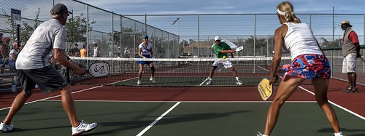
PICKLEBALL
This Photo by Unknown Author is licensed under CC BY-NC-ND

Slide 2
PICKLEBALL
Pickleball is the fastest growing sport in the United States. Known for its ease of learning and appeal to all ages. Pickleball combines elements of Badminton, Tennis and Ping Pong. It is played on a court the size of a Badminton court, with a low net similar to Tennis, and with what looks like an oversized ping pong paddle and a whiffle ball.

Slide 3
HISTORY
Pickleball was invented in Washington during the summer of 1965 by two men that found their families sitting around with nothing to do while on vacation. Their property had an old badminton court so they looked for some badminton equipment and could not find a full set of rackets. They improvised and started playing with ping-pong paddles and a perforated plastic ball.
According to one of the inventors, the game was officially named after a family dog, Pickles, who would chase the ball and run off with it.

Slide 4
The Court
Pickleball is played on a rectangular 44’ by 20’ court. The court is divided into two sides by a low net.
There are two sidelines, two baselines, a centerline on each side, as well as two non-volley lines, which creates an area called the “Kitchen” in Pickleball.
The center line divides each side into two service courts, the left service court and the right service court. This allows players to know where to serve the ball and stand when serving.

Slide 5
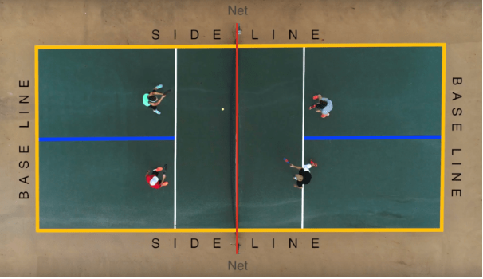
THE COURT

Slide 6
Rules & Regulations
The start of a game begins with a serve. The player standing in the right service court is always the first server, whether at the beginning of a game or on a side-out. Before serving the server must call the score.
A Pickleball serve must be hit underhanded from behind the baseline cross court into the opposing team’s service court. The serve must clear the net and not land in the kitchen.

Slide 7
Rules & Regulations
Players may not hit the ball while standing in the kitchen unless the ball has already bounced on their side. Players may not step into the kitchen to volley the Pickleball. Players may not enter the kitchen on a volley even if their momentum carries them into the zone.
An important rule in Pickleball is the double bounce rule. The double bounce rule says the ball must bounce once on each side before either team may start volleying the ball in the air.

Slide 8
Matches are played best two games out of three. Games are played to 11 points, win by two. If playing one game, it is played to 15 points, win by two. Only the serving team can score a point by winning a rally. The player in the right service court will always serve first for a team. If the serving team scores a point, the two players switch places, so the first server now serves from the left service court. The serving team will continue switching places until they lose a rally. When the serving team loses a rally, the second server now serves from his current position. Once the serving team loses another rally, the opposing team now has two chances to serve. This is called a side out.
SCORING

Slide 9
Videos
https://www.playpickleball.com/
https://www.youtube.com/watch?v=fTvPYdKZqO0

Slide 10
References
AxiomThemes.(2019). Pickleball. Retrieved from https://www.playpickleball.com/

