Slide 1
Outdoor Ethics
Conservation
https://www.youtube.com/watch?v=m4d65Arkd4k

Slide 2
Ethics
Judicial notion of good and bad practices
What someone will do when no one is looking
Governs our personal and group decisions on how we behave in our interactions with the natural world
View of outdoor ethics is changing over time from a perspective of consumption to one of preservation
Outdoor practices from years ago may be disputed as unacceptable in outdoor recreation today
Increased disappearance of natural settings, increased abuse and misuse of nature due to ignorant recreational practices

Slide 3
Conservation
Protection, preservation or restoration of the natural environment, natural ecosystems, habitats, and wildlife
Making life more sustainable for the planet
Avoiding or minimizing negative impacts on the planet by humans
Preserving nature for future generations

Slide 4
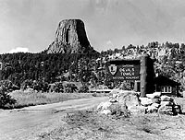
History of the Conservation Movement
Began in 1890
Progressive Era – progressives favored protecting the environment
Writings by Thoreau, Muir, Wesley, Pinchot and other influential people convinced Americans of the importance to the nation of preserving land, water, and wildlife
As cities became crowded, people took up outdoor recreation to escape the crowds of the cities: camping, bird watching, fishing, hunting, etc.
Americans began to value wilderness areas for more than just hunting, logging, and farming

Slide 5
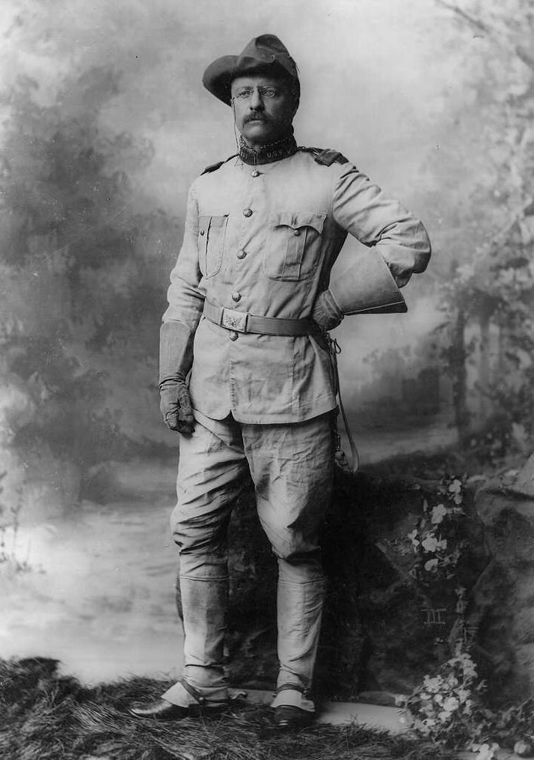
Teddy Roosevelt – “conservationist president”
“We have become great because of the lavish use of our resources. But the time has come to inquire seriously what will happen when our forests are gone, when the coal, the iron, the oil, and the gas are exhausted, when the soils have still further impoverished and washed into the streams, polluting the rivers, denuding the fields and obstructing navigation.”
As president 1901-1909
Created United States Forest Service
Protected nearly 230 million acres of public land
Helped grow the National Park System which later became the National Park Service in 1916

Slide 6
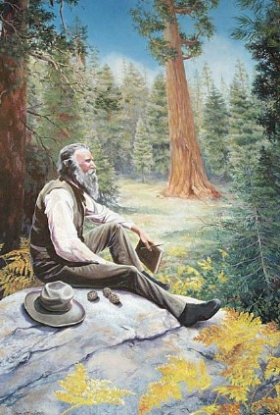
Influential Conservationist – John Muir
Father of the Conservation movement
Conveyed his ideas to the public through writings published in magazines and public speaking
Most famous for writings of Yosemite
Known as an inventor, botanist, self-taught genius, Wildman of the wilderness
Influenced Teddy Roosevelt’s national park plan while camping for 3 days in Yosemite
“Everybody needs beauty... places to play and pray in, where Nature may heal and cheer and give strength to body and soul alike,” wrote Muir (c. 1902). (Corbis)
Helped establish Yosemite National Park and Sequoia National Park
Lifelong legacy was instrumental in strengthening the National Park Service
Founded the Sierra Club

Slide 7
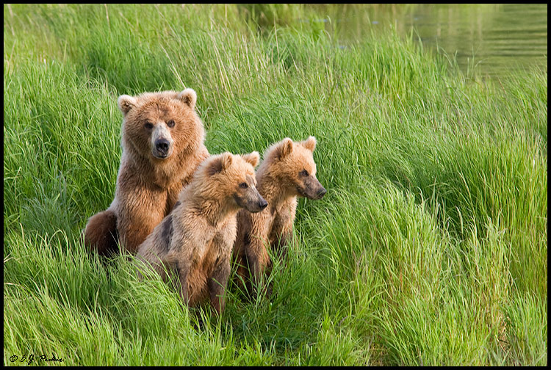
Modern Conservation
After WWII
Newly acquired affluence of Americans made them unwilling to accept environmental degradation in the name of progress
Continued effort to preserve, conserve resources and wilderness as well as improve the urban environment
Make the world production efficient and sustainable
Closely linked with Environmentalism – consumer oriented effort to improve quality of life

Slide 8
Conservation Organizations
The Nature Conservancy
World Wildlife Fund
Natural Resources Defense Council
The Sierra Club
International Crane Foundation

Slide 9
Outdoor Ethics
Leave No Trace
https://www.youtube.com/watch?v=_s1QM2G034w

Slide 10
Leave No Trace
Refers to a set of outdoor ethics promoting conservation in the outdoors
Golden rules of outdoor recreation: leave the wild places you visit the way you would like to find them.
Built on 7 main principles
Plan ahead and prepare
Travel and camp on durable surfaces
Dispose of waste properly
Leave what you find
Minimize campfire impacts
Respect wildlife
Be considerate of other visitors

Slide 11
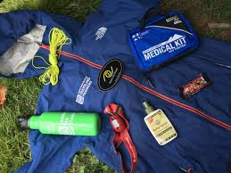
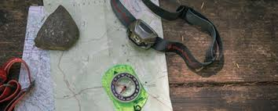
1. Plan Ahead and Prepare
Carry a map and know where you are going to reduce the chance of having to travel off trail.
Always pack out trash, repackage food to reduce waste.
Schedule trips during low-use times and travel in small groups.
Prepare for extreme weather, hazards, and emergencies.
Know the regulations and special concerns for the area you’ll visit

Slide 12
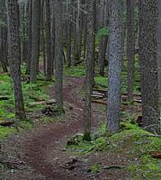
2. Travel and camp on durable surfaces
Camp on durable surfaces. These include established trails and campsites, rock, gravel, dry grasses or snow.
Protect plant and wildlife habitat by camping at least 200 feet from lakes and streams.
Avoid places where impacts are just beginning
Good campsites are found, not made. Altering a site is not necessary
Walk in single file line in the middle of the trail, even when wet or muddy.

Slide 13
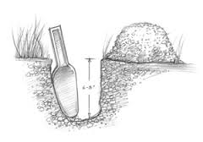
3. Dispose of waste properly
Pack it in, pack it out.
Do your “business” in cat holes (6-8 inches deep) at least 200 feet from water, campsite and trails. Cover the hole when done. Use biodegradable toilet paper when possible.
To wash yourself or your dishes, carry water 200 feet away from streams or lakes and use small amounts of biodegradable soap. Scatter strained dishwater.

Slide 14
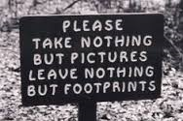
4. Leave what you find
Preserve the past: examine, but do not touch cultural or historic structures and artifacts.
Leave rocks, plants and other natural objects as you find them.
Avoid introducing or transporting non native species.
Do not build structures, furniture, or dig trenches.

Slide 15
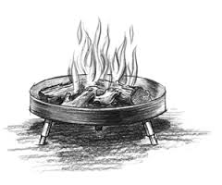
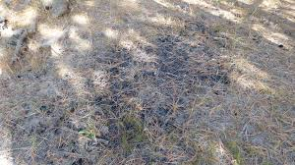
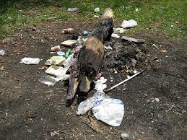
5. Minimize campfire impacts
Campfires can cause lasting impacts to the backcountry. Use a lightweight stove for cooking and use a candle lantern for light.
Where fires are permitted, use established fire rings, fire pans, or mound fires.
Keep fires small. Only use sticks from the ground that can be broken by hand.
Burn all wood and coals to ash, put out campfires completely, then scatter cool ashes.

Slide 16
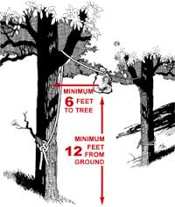
6. Respect Wildlife
Observe wildlife from a distance. Do not follow or approach them.
Never feed animals. Feeding wildlife damages their health, alters natural behaviors, and exposes them to predators and other dangers.
Protect wildlife and your food by storing rations and trash securely.
Control pets at all times, or leave them at home.
Avoid wildlife during sensitive times: mating, nesting, raising young, or winter.

Slide 17
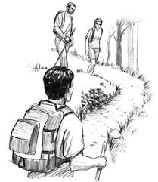
7. Be considerate to other visitors
Respectful of other visitors
Be courteous. Yield to other users on the trail.
Yield to the downhill side of the trail when encountering a group

Slide 18
Leave No Trace Activity
Find an example of a current event that demonstrates ignorance of the LNT philosophy or failure to implement the LNT philosophy. Describe the incident and how it conflicts with LNT.

