Slide 1
Orienteering
Hillgrove High School
https://www.youtube.com/watch?v=FnE-hftGQoU

Slide 2
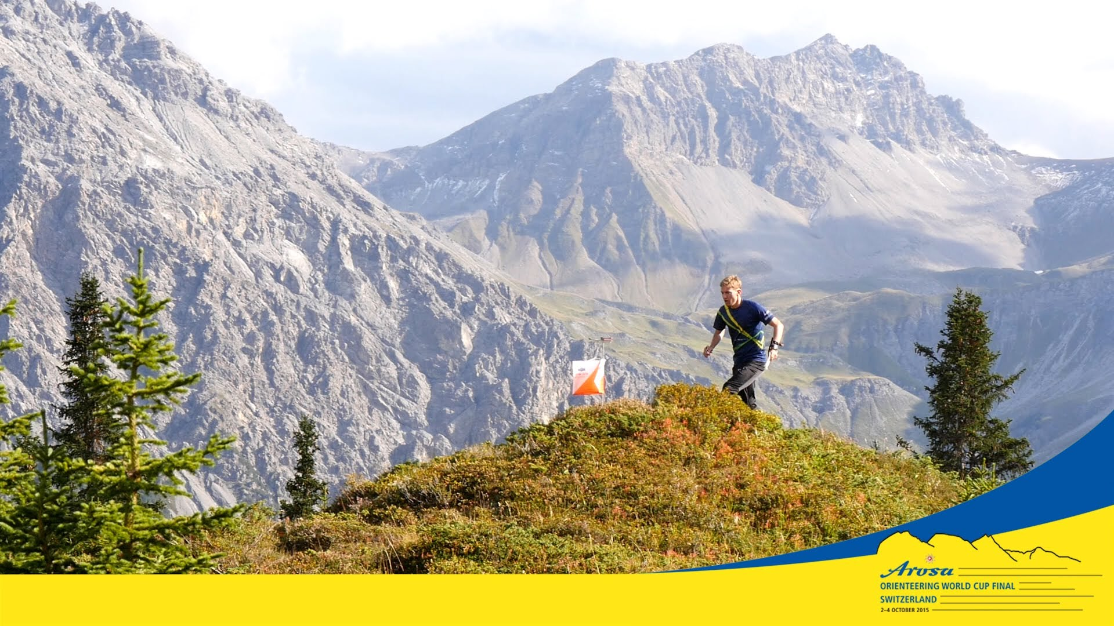
What is Orienteering??
Timed race including the use of:
  highly detailed maps and compass
  control points with start and finish
Combines racing with navigation
Courses may also be completed by walking

Slide 3
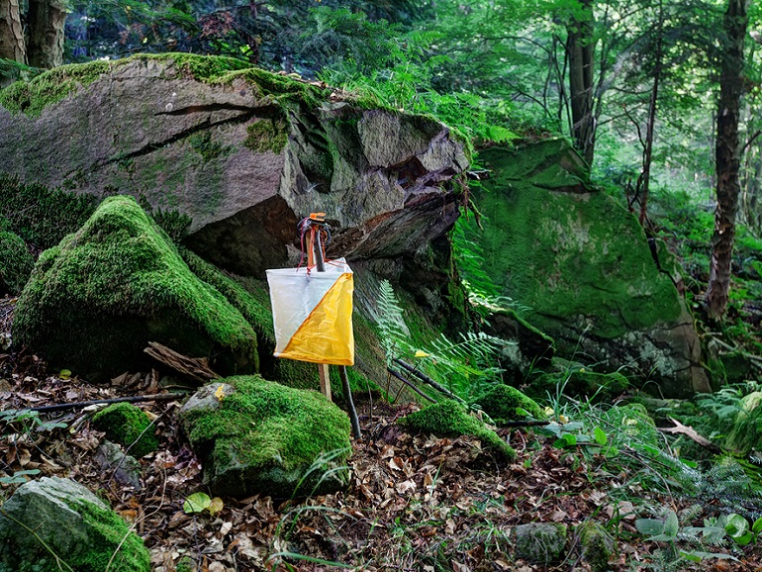
What does a standard course consist of?
Start and Finish
Score/Punch/Control Card
Control Flags
  Mark control site location
Control Sites
  marked by circles
    Centered on the feature it is to be found
      Defined by control descriptions
  connected by lines
  numbered in the order they are to be visited

Slide 4
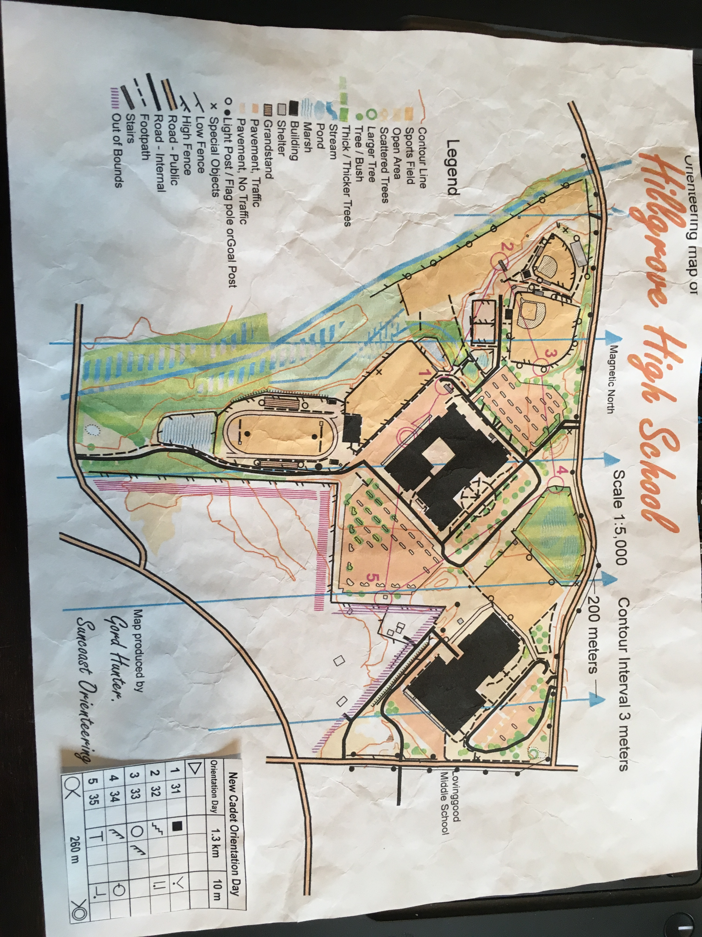

Slide 5
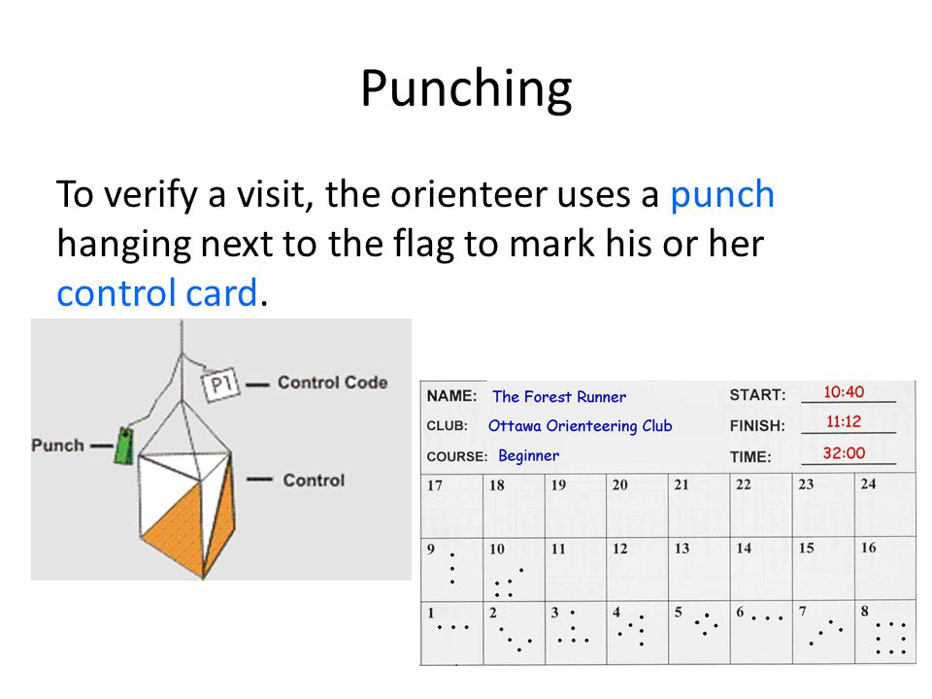
Finish the race!!!
  Starting
    Staggered starts
    Relays
    Mass start endurance
    Score-0
  Punching
    Hanging punch marks scorecard
    Different punch patterns
  Routing
    Not specified
    Entirely up to the orienteer

Slide 6
Sources
https://www.youtube.com/
https://orienteeringusa.org/new-o/what-orienteering

