Slide 1
Exercising Safely
Ch 2

Slide 2
Medical screenings
Get one of these before you start a program of vigorous physical activity
Basic assessment of a person’s overall health and personal fitness
Performed by a doctor or nurse
Who?
People with poor lifestyle habits
People over 40
Overweight or obese people
People with chronic diseases

Slide 3
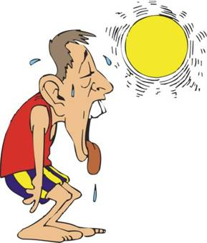
Exercising in the heat
Environmental conditions can potentially pose a risk factor for personal health
Does that mean we can’t exercise in the heat? NO!!!
As long as we follow some simple guidelines and common sense, most activities can be carried out safely

Slide 4
Extreme Heat and Fluid Balance
During exercise your body produces heat causing your temperature to rise
To prevent overheating, you sweat
When the sweat evaporates, heat is released from your body lowering your temp
Fluid balance – describes the body’s ability to balance the fluids taken in and those lost through sweat and excretion
Dehydration occurs when the body loses too much water which can put you at risk for heat related illnesses

Slide 5
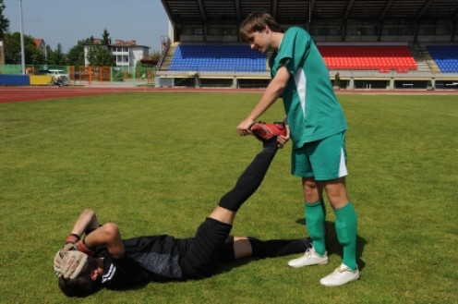
Heat Illness - Mild
Mild
Heat cramps – muscle spasms resulting from the loss of large amounts of water and salt through perspiration or excretion
Minimized by drinking plenty of fluids before and during physical activity

Slide 6
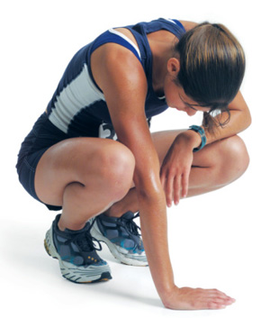
Heat illness - moderate
Moderate
Heat exhaustion – overheating of the body resulting in the following symptoms
Cold, clammy skin
Weakness
Headache
Rapid pulse
Nausea
Heavy sweating
Dizziness
Weight loss
Stop activity, Move person to cool place and drink plenty of fluids

Slide 7
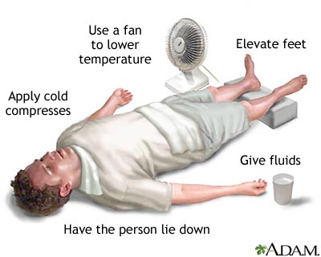
Heat iLlness - Severe
Severe
Heat Stroke – condition in which the body can no longer rid itself of heat through perspiration – LIFE THREATENING – CALL 911
Symptoms
Very high body temp
Rapid pulse
Loss of concsiousness
Hot and dry skin
Move person to cool place
sponge body with cold water until EMS arrives

Slide 8
How to avoid heat related injuries
Gradually increase the intensity of activity
Acclimatization – allowing your body to adapt slowy to the weather conditions, 5 to 10 days
Fluid Intake – can lose up to 3 liters of water per hour when exercising in hot weather
Before activity – 12 to 20 ounces 10 – 20 minutes prior to
During activity – 12 to 36 ounces per hour
After activity – 16 ounces per pound lost
Clothing –
Lightweight
Cotton to absorb moisture and promote evaporation
Loose fitting to allow for air flow near the skin
Light color
sunscreen
Heat Stress Index – scientific measure of the combined effects of heat and humidity on the body
Indicates risk of injury

Slide 9
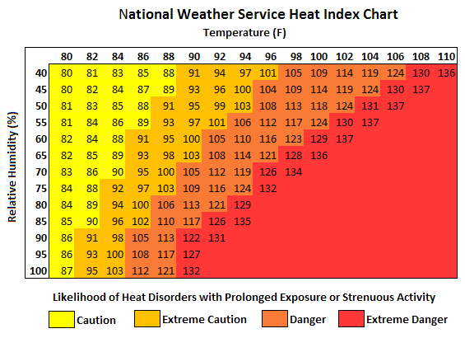
Heat Index chart

Slide 10
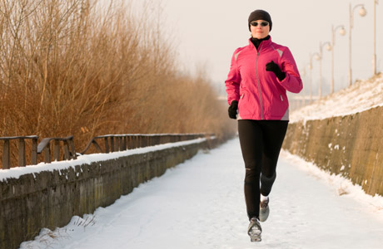
Exercising in the cold
There are risks associated with exercising in extremely cold temps, wind and rain when a person is not properly equipped
Where warm, loose-fitting layers and protect the extremities where a lot of heat is lost
Hypothermia – condition in which the body’s temperature drops below normal
Brain and body systems can’t function properly at low temps
Can be fatal
Person may act disoriented or lose motor control
Frostbite – tissue damage from freezing usually to the face, hands, head, and feet
Wind-chill – combined influence of wind and temp on the body

Slide 11
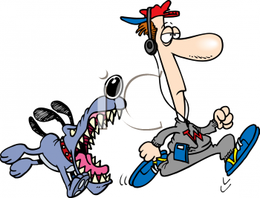
Other Outdoor concerns
Air pollution – avoid exercising when air quality is poor or pick a time of day when motor vehicle traffic is lighter
Unleashed dogs – yell at dog to stop, walk don’t run away
Personal safety – use common sense – exercise
In well lit areas
With someone
In reflective clothing if it is dark
Avoid isolated areas and high-crime areas if you are alone

Slide 12
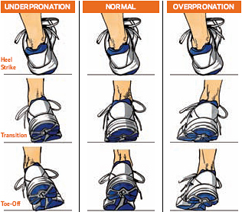
Footwear for exercise
Pick shoes that are designed for your specific type of exercise
High top shoes for basketball
Lightweight shoes with cushioning for running
All should have a non-skid sole
Pronation – normal motion of the foot as you walk or run, the heel striking the ground through the normal inward role of the foot
Body’s weight is distributed evenly over the surface of the foot
Over-pronation and under-pronation can put people at risk for injuries
See page 49 Figure 2.6

Slide 13
Buying shoes
Seek advice of an expert
Shoe should provide proper support, flexibility, and cushioning
Snug heel
About ½ inch from longest toe to end of shoe
Try shoes on before you buy
Wear the socks you would wear for exercise
Remember your feet swell during exercise

Slide 14
Preventing fitness injuries
Biomechanics – the study and application of principles of physics to human motion
Using good form in jogging and walking will minimize the risk of injury from the stress placed on the body during exercise
Good form =
Breath through your nose and mouth
Relax your neck, arms, and shoulders
Hands held loosely
Elbows flexed at about 90 degrees
Stand upright
Use a smooth, even stride with heel-toe strike

Slide 15
Common injuries
Cuts, scrapes – keep clean with antiseptic and cover with bandage
Bruises – no treatment necessary
Blisters – caused by friction between skin and other surface
Common when you first start training
Avoid by breaking in shoes and wearing socks that fit well
Treat by cleaning with antiseptic and bandaging
If you have medical supplies, go ahead and pop and treat the blister
If you do not have supplies, leave the blister intact

Slide 16
Common injuries
Muscle cramps – painful spasms that occur during exercise
Associated with dehydration
Side-stitch – cramp in the side of abdomen that occurs during vigorous running
Avoid cramps by staying hydrated and using a proper warm-up and cool down
Treat cramps with stretching and massage
Connective tissue injuries – tissues that hold joints together
Tendons – connects muscle to bone
Ligaments – connects bone to bone
Cartilage – surrounds end of joints to prevent bone from rubbing on bone
Shin splints – tears or inflammation of the tendons and muscles along the shin bone
Strain – tearing of muscle or tendon
Sprain – tearing of ligaments

Slide 17
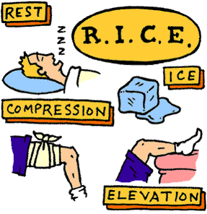
Treating injuries
Rest the injured part
Ice to reduce the swelling (don’t apply ice directly to skin, use towell)
Compression with an elastic bandage
Elevation
Wearing the correct shoes, following proper warm-ups and cool downs, and use good biomechanics can prevent many injuries.

