Slide 1
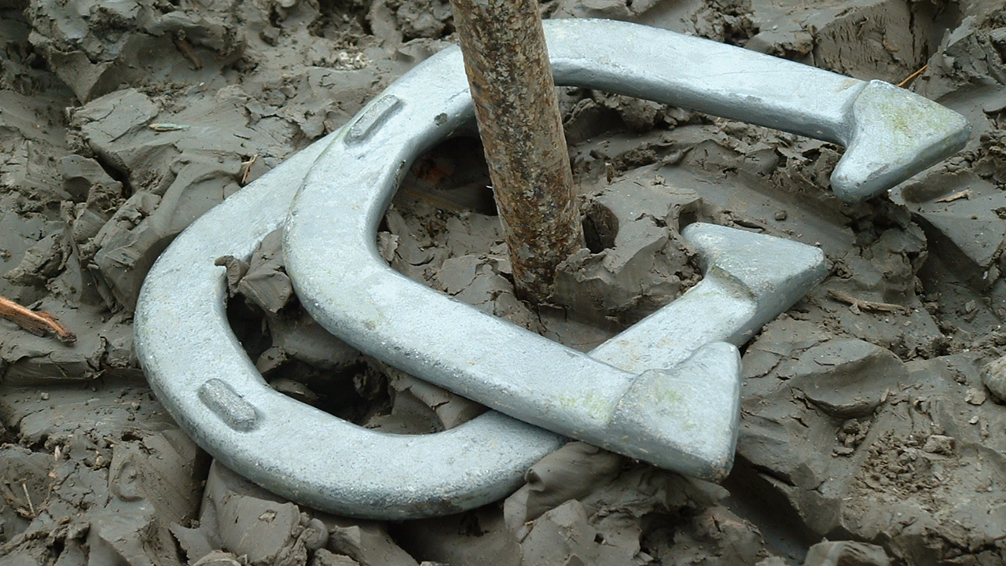
HORSESHOES
This Photo by Unknown Author is licensed under CC BY-SA

Slide 2
HISTORY
Horseshoes was started by the Greek soldier that had a lot of time on their hands.
Originally, the game was played on dirt courts with stakes 2 inches above ground level.
It was not until the late 1930’s that the stakes were raised from 2 inches to 14 inches above ground level.
The first horseshoe pitching tournament was open to the world in the summer of 1910 in Bronson, Kansas.

Slide 3
PLAYING COURT
The horseshoe court is 6 feet wide and a minimum of 46 feet long with the stakes 40 feet apart. The pitcher’s box is the square 6 ft by 6 ft area at each end of the court. The pitcher’s box includes 3 things:
The pit, the pitcher’s platform, and the stake. The pit is a rectangular area filled with sand or dirt.
The purpose of the filler is to keep the horseshoes from bouncing excessively.

Slide 4
TERMINOLOGY
Value of the Shoe:
Ringer – a shoe which comes to rest encircling the stake. A ringer must not touch any part of the stake. Has a value of 3 points.
Shoe in count – a shoe which is not a ringer, but comes to rest 6 inches or closer to the stake. Has a value of 1 point.
A “leaner” or any other shoe touching the stake is considered a shoe in count and has a value of 1 point. Amateurs often count a leaner as 2 points.
Shoe out of count – a shoe which comes to rest more than 6 inches from the stake and has a scoring value of 0 points.

Slide 5
LENGTH OF THE GAME
The game is broken down into innings consisting of four pitched shoes, 2 by each contestant.
The length of the game is determined before play begins. There are 3 options:
Points Limit – Game played to a predetermined number of points. 21 is common for recreational play. 50 is standard in tournament play.
Shoe limit – Game played to a predetermined number of shoes. Has to be an even number. When the amount is reached, the player with the highest score is the winner
Point limit or shoe limit – Combination of the point and shoe limit. (ex. 21points or 30 shoes)

Slide 6
SCORING
There are two methods of scoring in horseshoes:
Cancellation – only one player can score in each inning.
Count All – all shoes thrown will count as points.

Slide 7
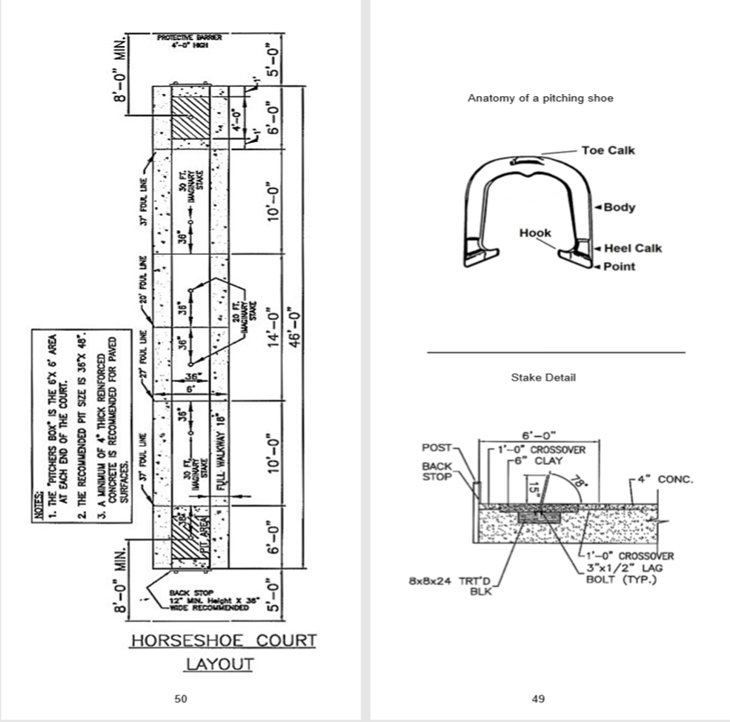
HORSESHOE DIAGRAM

Slide 8
VIDEO LINKS:
https://www.youtube.com/watch?v=5eEZ9q33kDc
Horseshoe Grips
https://www.youtube.com/watch?v=Fk5yJcqlJkQ

Slide 9
References
National Horshoe Pitchers Association. (2019). Retrieved from
https://www.horseshoepitching.com/

