Slide 1
Hiking and Backpacking

Slide 2
Hiking and backpacking
Hiking is generally a day trip where departure and return occur within the same day.
Backpacking involves spending one or more nights in the outdoors, covering much greater distances.
Weather and dehydration are two common threats to hikers who are unprepared for the conditions.
Hikers should carry:
-first aid kit, food, water, and adequate layers of clothing in case conditions turn inclement.

Slide 3
Leave no trace
7 principles
Plan ahead and prepare
Travel and camp on durable surfaces
Dispose of waste properly
Leave what you find
Minimize campfire impacts
Respect wildlife
Be considerate of other visitors
https://www.youtube.com/watch?v=_s1QM2G034w

Slide 4
Backpacks
It is important to learn how to properly don (put on) and shuck (take off) a pack.
Fuel should be kept below food and in external pockets if possible in case fuel leaks
Loosen all straps before donning the pack. Once the pack has been donned, the pack is ready for adjustments
Packing:
Bottom: light weight items that will not be needed until stopping to make camp. Ex: Sleeping bag
Middle: Heaviest items. Ex: clothes, pot sets, stoves, food, etc.
Top: Lighter items needed throughout the day. Ex: Rain gear, tarp, jacket, change of clothes, etc.
Hood (top compartment): small items needed throughout the day. Ex: Camera, binoculars, first aid kit, compass, map, snacks, etc.

Slide 5
Fitting a Backpack
After the pack is donned:
Check that the hip belt is over the hipbones, and fasten the buckle.
Tighten shoulder straps until snug. There should barely be enough room between the strap and shoulder for a hand to fit between.
Adjust the top loader straps until the top compartment is touching the back of the head.
Adjust the sternum strap to take stress off shoulders
Shucking a Backpack:
Leaning slightly forward, loosen the shoulder straps and unbuckle the hip belt. Slide one arm out of the shoulder strap and grab the opposite strap. Move the pack from your back, to your knees, to the ground.

Slide 6
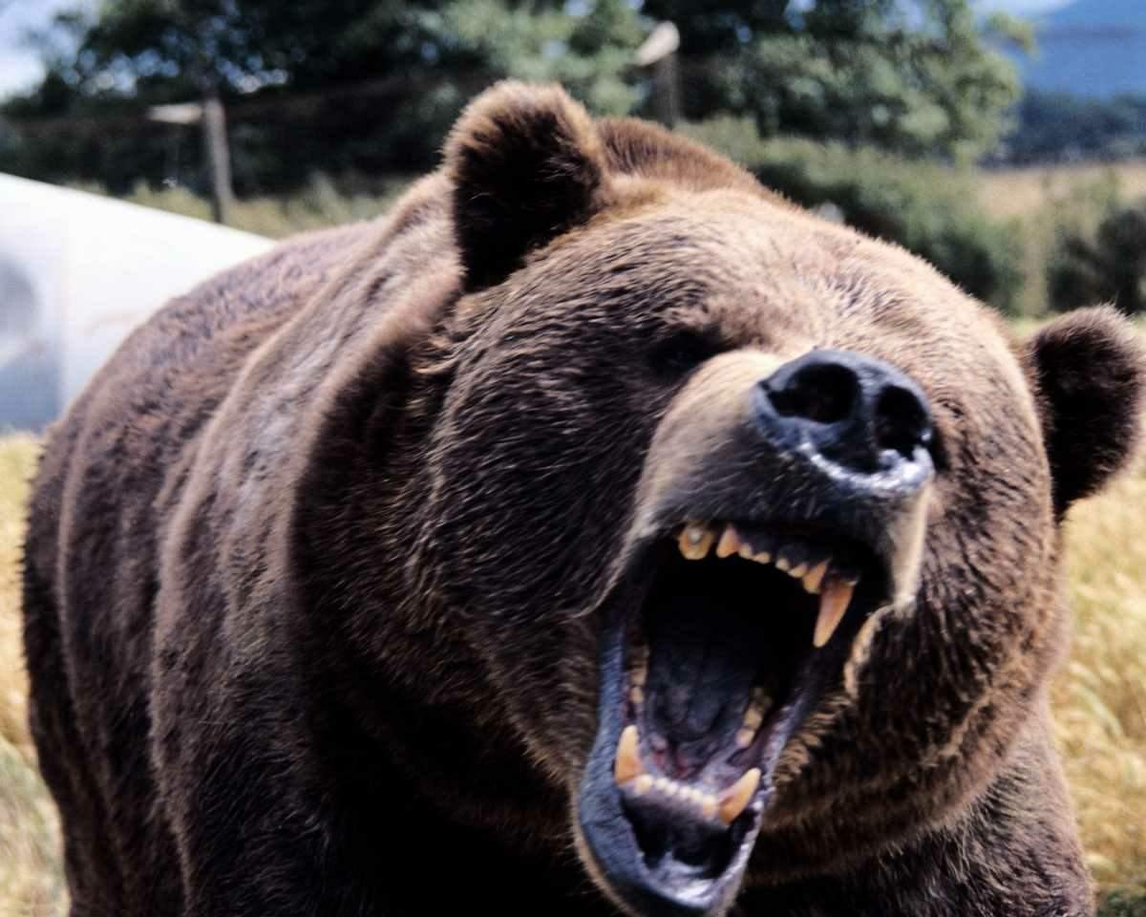
Bear Encounter
TO DO
Stay calm
Stand Tall and Back away slowly
If hiking with other hikers: Get in one big group
NOT TO DO
Run away
Approach the bear
Hit it with objects
Feed it
https://www.youtube.com/watch?v=X8LcLAUqDEM

