Slide 1
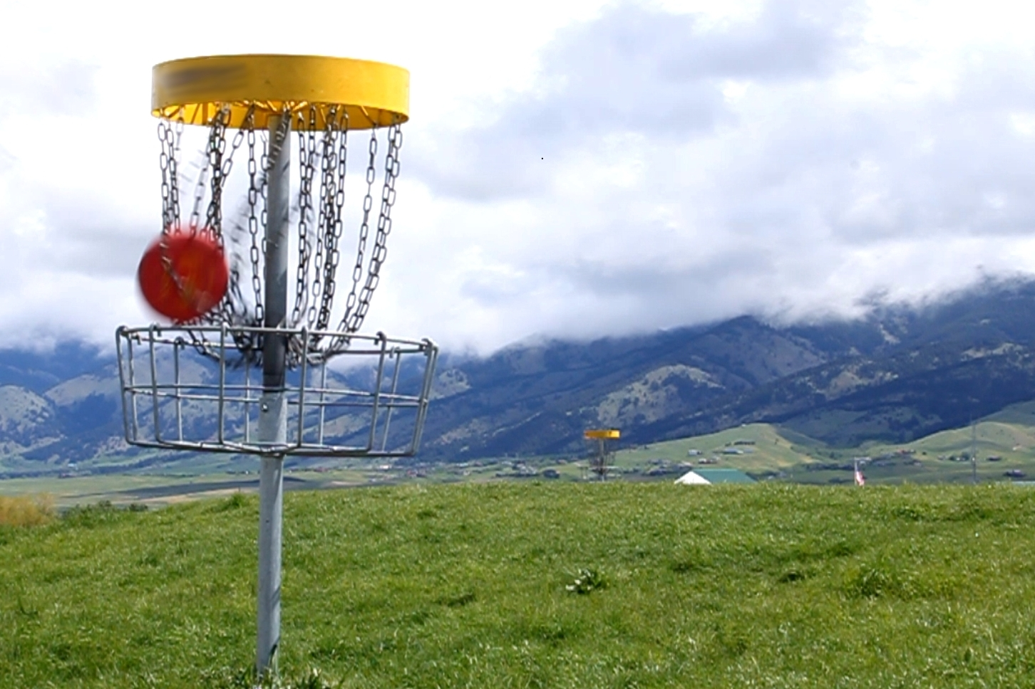
Disc Golf Key Terms https://www.youtube.com/watch?v=hfHnT1HilMM
Par-the number of strokes a first-class player should normally require for a particular hole or course
Albatross- 3 under par
Eagle –2 under par
Birdie-1 under par
Bogey-1 over par
Double Bogey-2 over par
Triple Bogey-3 over par
Fore-Word used to warn others of an on coming disc
Hole-out-A successful putt/throw that comes to rest suspended in the chains or at rest in the basket tray.
Out-farthest away from the target

Slide 2
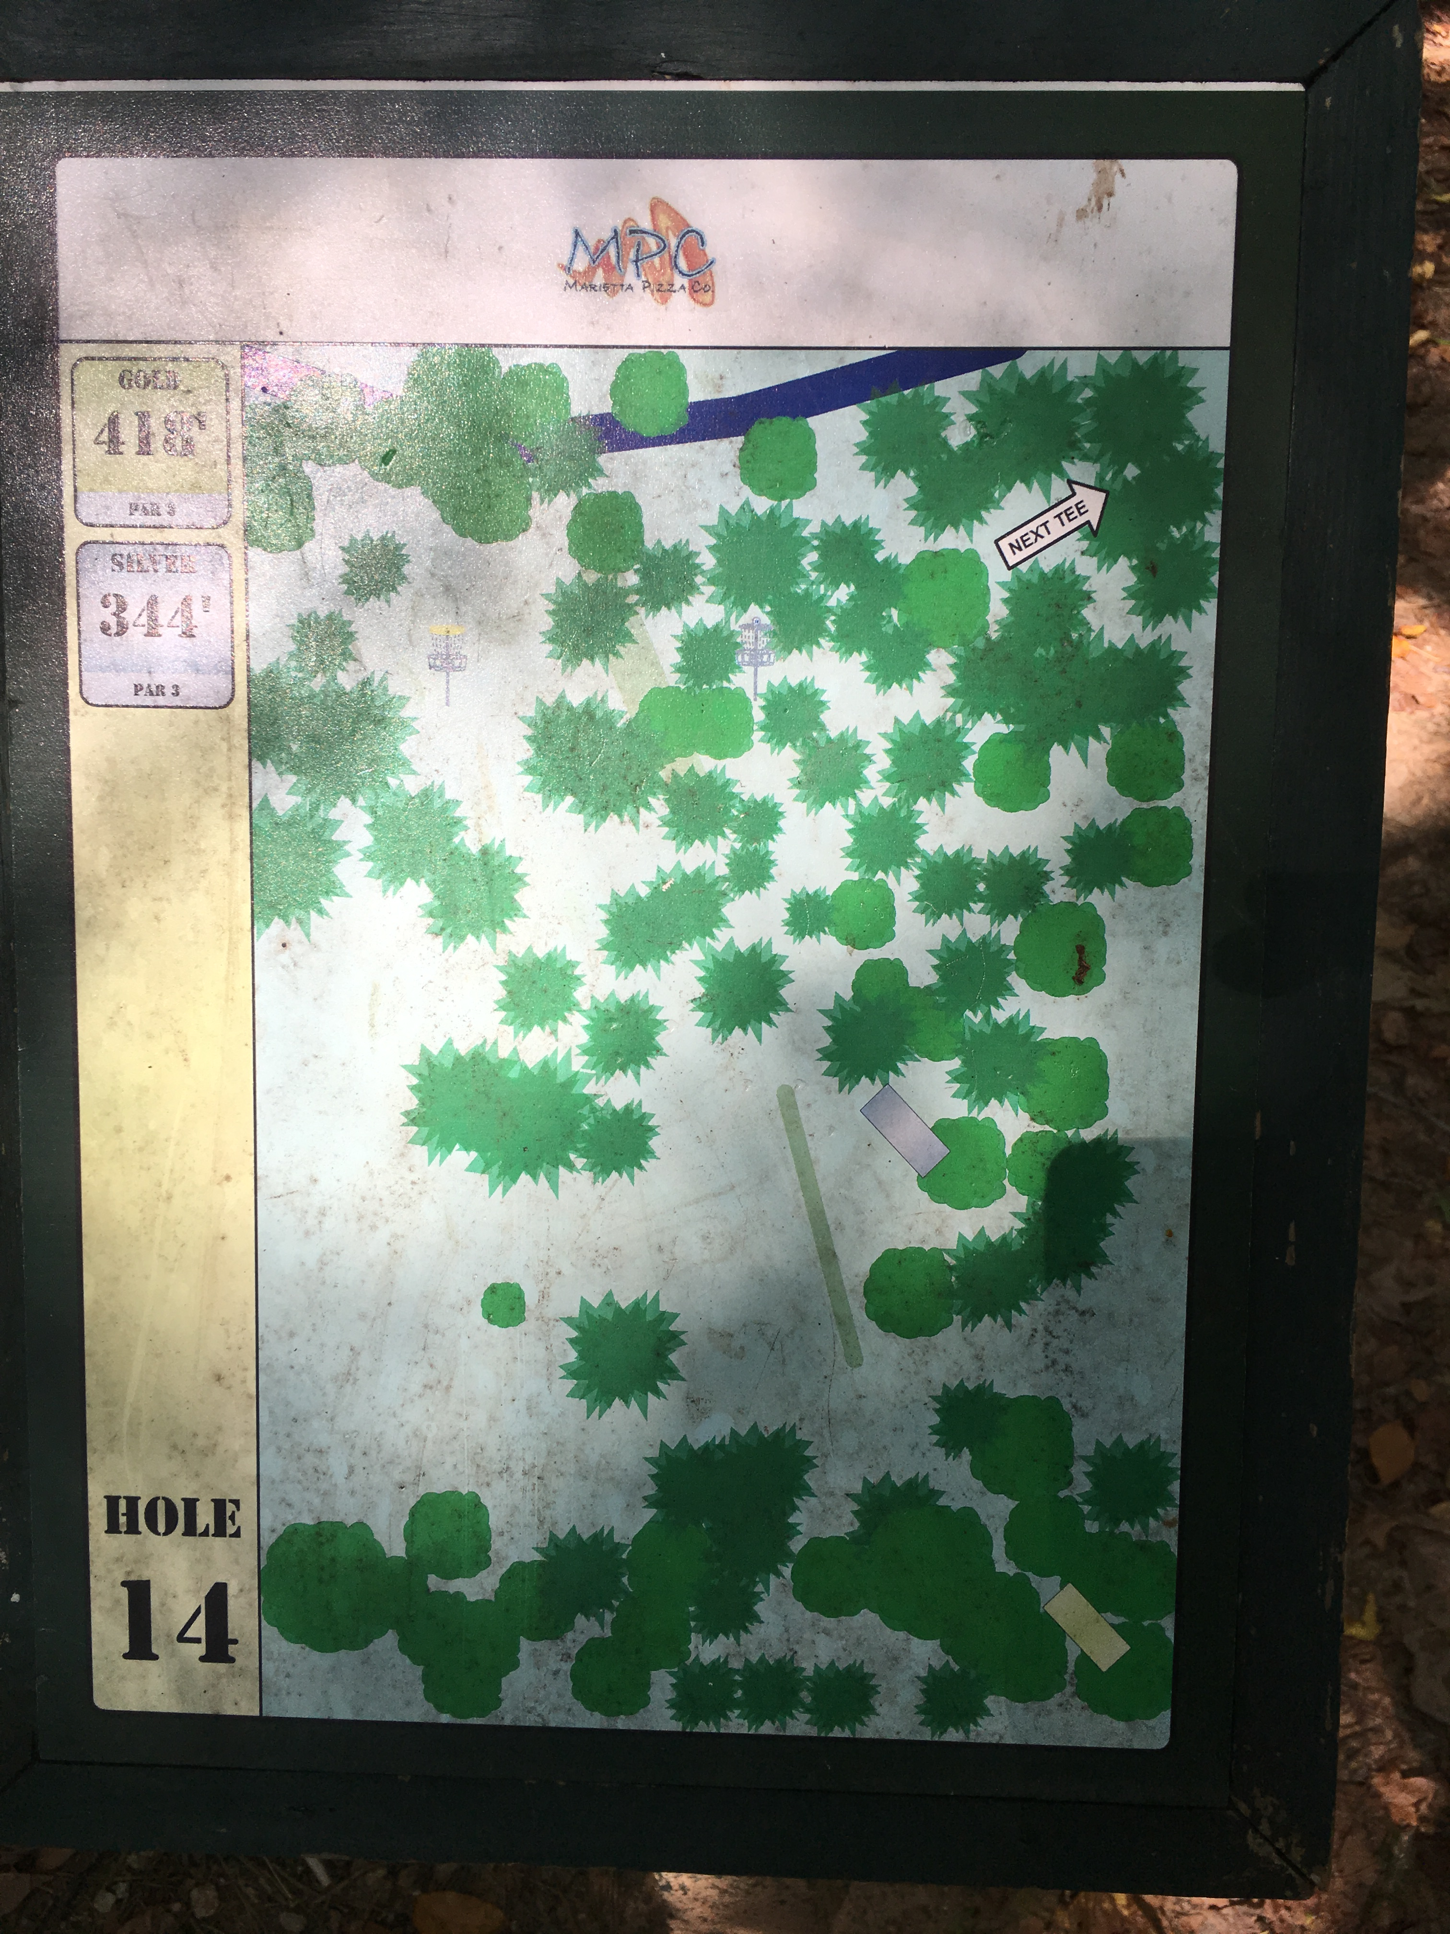

Slide 3
Most Common Discs
1 Driver-Has pointy edges and is used to gain the most amount of distance
2 Fairway or Midrange-A balance between accuracy and distance
3 Putter-Highly Accurate, but doesn’t travel very far
Power Grip
Common grip used for distance
All four fingers are placed under the Frisbee and the thumb is placed on top
https://www.youtube.com/watch?v=zBk-pwH3vsA

