Slide 1
Alcohol

Slide 2
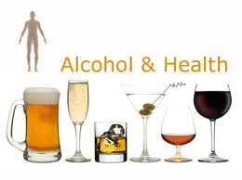
What is alcohol?
Aka – ethanol: the type of alcohol in alcoholic beverages
An addictive drug that is physically damaging
Produced through the process of fermentation
Legal drinking age = 21 (including purchasing and possession)

Slide 3
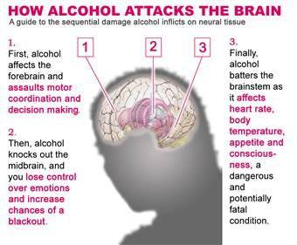
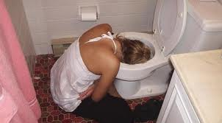
Short-term Effects of Alcohol
It is a depressant – slows down the central nervous system
Slows reaction time
Impairs vision
Impairs judgment
Thought processes become disorganized
Increases urine output
Increases stomach acid which can cause nausea
Intoxication – state in which the body is poisoned by alcohol and the person’s physical and mental control is significantly reduced

Slide 4
Factors that Influence Effect of Alcohol
Body size – smaller people feel the effect of the same amount of alcohol faster than a larger person
Gender – acts faster on females than males
Food – food in stomach slows the absorption of alcohol into the bloodstream
Rate of intake – intoxication occurs when a person drinks faster than the liver can metabolize the alcohol
Amount
Medicine – some medicines can heighten the effect of alcohol

Slide 5
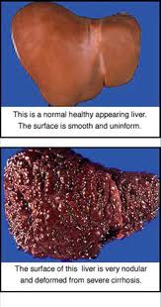
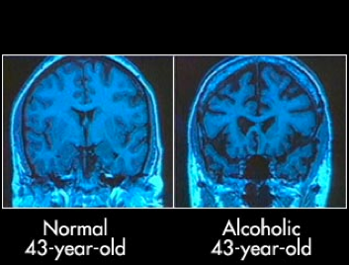
Long Term Effects of Alcohol
Damage to brain cells and reduction of brain size
Increase in blood pressure
Build up of fat cells and scar tissue in the liver
Damage to lining of the stomach causing ulcers, cancer, and destruction of the pancreas
Some long term effects can be reversed over time if someone quits drinking

Slide 6
Binge Drinking and Alcohol Poisoning
Binge drinking – drinking 5 or more alcoholic beverages in one sitting
Binge drinking can lead to alcohol poisoning.
Alcohol poisoning – a severe and potentially fatal physical reaction to an alcohol overdose
Symptoms:
Mental confusion or stupor]
Coma or inability to be roused
Vomiting and seizures
Slow respirations (fewer than 8 breaths per minute)
Irregular heartbeat
Low body temp

Slide 7
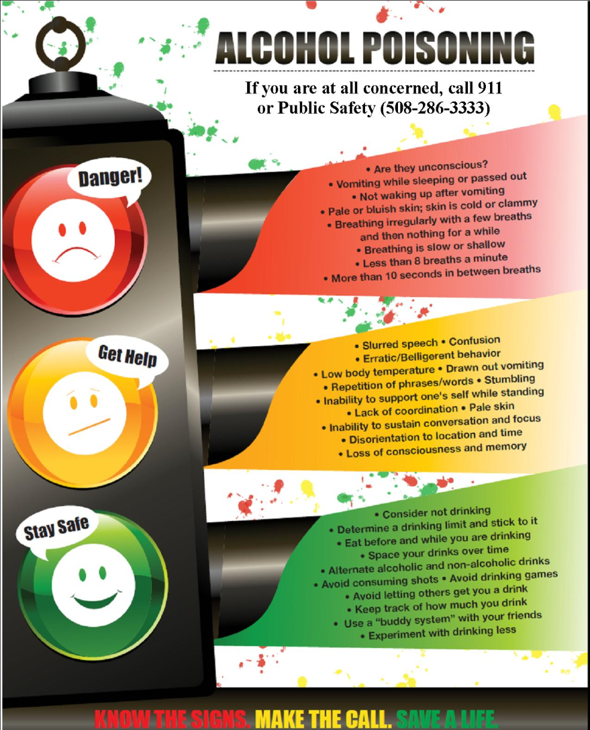
Alcohol Poisoning
It depresses the central nervous system which controls involuntary actions like breathing and the gag reflex.
If someone is drunk and passes out, they may choke on their own vomit.
Blood Alcohol level in the bloodstream continues to rise even when someone is passed out because alcohol in the stomach is still being absorbed
If you suspect alcohol poisoning – call 911

Slide 8
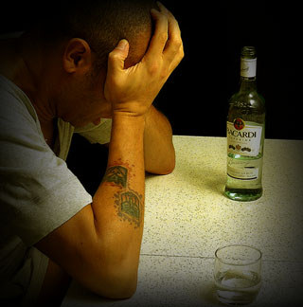
Consequences of Alcohol Use
Psychological dependence – a person believes they need alcohol in order to function or feel good
Physiological dependence – a person has a chemical need for the drug

Slide 9
Factors Influencing Teen Alcohol Use
45% of teens had at least one drink in 30 days (National Survey)
Peer pressure – teens are more likely to drink if their friends drink
Family – teens are less likely to drink if their family members don’t drink
Media messages – make drinking look glamorous and fun, without any negative consequences

Slide 10
Other effects of alcohol use on teens
When alcohol is used:
Fights are more likely to occur
Teens are more likely to be victims or perpetrators of violent crimes such as rape, aggravated assault, and robbery
Teens are more likely to be sexually active and twice a likely to contract an STD

Slide 11
Alcohol and the Family
Alcohol abuse – excessive use of alcohol
25% of youth are exposed to alcohol abuse
Kids that live in homes with alcohol abuse are at high risk for:
Neglect, abuse, isolation
Economic hardship
Personal use of alcohol
Mental illness
Alcoholism – disease in which a person has a physical or psychological dependence on alcohol
People who begin drinking as a teen are 4 times more likely to become an alcoholic than someone who waits until adulthood

Slide 12
Benefits of Living Alcohol-free
Maintaining a healthy body
Establishing healthy relationships
Making healthy decisions
Avoiding risky behaviors
Avoiding illegal activities
Avoiding violence
Achieving your goals
Plan ahead on how you will say “no” when faced with pressures to drink

Slide 13
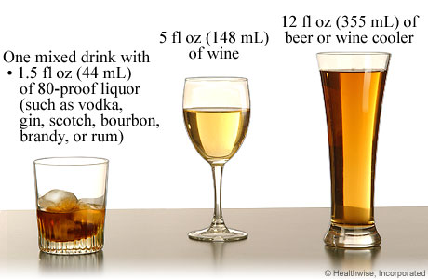
Alcohol and Driving
Blood alcohol concentration (BAC) – amount of alcohol in a persons blood expressed as a percent
Depends on:
quantity and type of alcohol consumed
Rate of consumption
Body size
Gender
Can cause:
Slow reflexes
Reduced ability to judge distances and speeds
Increase in risky behaviors
Reduced concentration
increased forgetfullness
Each contains .5 oz alcohol

Slide 14
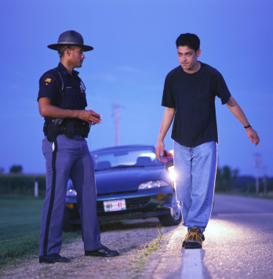
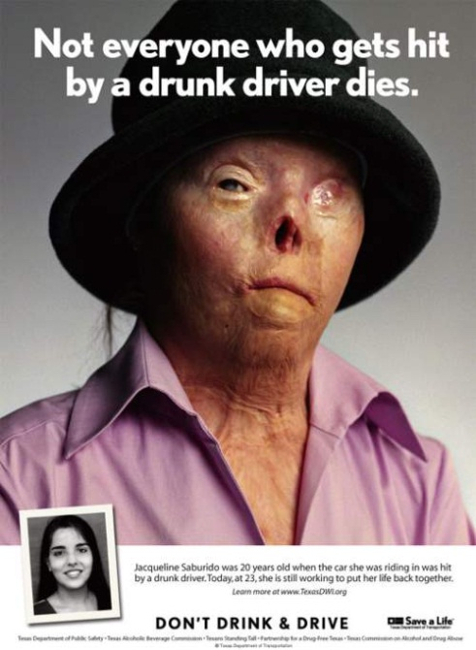
Driving While Intoxicated
Aka DUI or DWI
Is illegal for Adults with BAC 0.08% or greater and for underage people with any BAC
Consequences
Injuries or death
Arrest, jail time, legal fees
Suspension or revocation of drivers’ license
Higher auto insurance premiums or cancellation of policy
DO NOT RIDE WITH SOMEONE WHO HAS BEEN DRINKING!

Slide 15
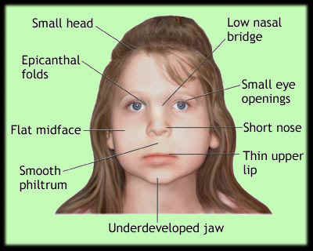
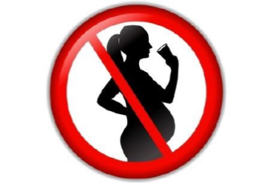
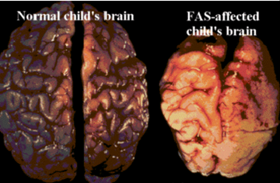
Alcohol and Pregnancy
When a pregnant woman drinks, the alcohol passes from the mother to the fetus
The fetus processes the alcohol much slower than the mother so the alcohol remains in the fetus for a longer period of time
Fetal Alcohol Syndrome – group of alcohol-related birth defects that include mental and physical problems
Effects are severe and permanent
Small head
Deformities of face, hands, or feet
Heart, liver, and kidney defects
Vision and hearing problems
Developmental disabilities
Poor coordination
Learning difficulties
Short attention span
Hyperactivity, anxiety, social withdrawel
DON’T DRINK IF YOU ARE PREGNANT

Slide 16
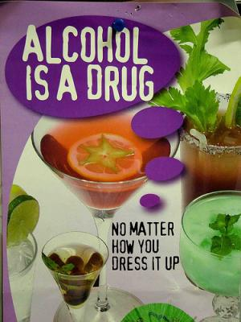
Alcoholism
A disease that effects the person who drinks and the others around them
Someone who is physically or psychologically addicted to alcohol
Symptoms =
cravings
inability to limit consumption
withdrawal symptoms when not drinking
tolerance (need to drink more in order to feel the effects)
Behavior of alcoholics vary from person to person. Some may be aggressive and violent, others may be withdrawn

Slide 17
Statistics on alcoholism
Partially due to genetics and environment
Children of alcoholics are 4x’s more likely to become alcoholics
People who start drinking as a teen are more likely to become alcoholics
17 million alcoholics and problem drinkers in US
Major factor in 4 leading causes of accidental death
40% of violent crimes are alcohol related

Slide 18
Stages of Alcoholism
Stage 1 – Abuse
Psychological and physical dependence develops
Blackouts and memory loss may occur
Person justifies or lies about drinking
Stage 2 – Dependence
Physical dependence
Drinker can’t stop
Drinker tries to hide problem
Stage 3 – Addiction
Liver is damaged so less alcohol will cause drunkenness
Severe withdrawal symptoms without alcohol
Codependency – someone ignores their own needs to care for alcoholic

Slide 19
Treatment for Alcoholics
Alcoholism cannot be cured only treated
Recovery – process of learning to live alcohol free
Takes lifelong commitment to sobriety
Steps to recovery
Admission
Detoxification
Counseling
Recovery
Support groups include:
Alcoholics Anonymous (alcoholic)
Al-Anon / Alateen (families and friends of alcoholic)

Slide 20
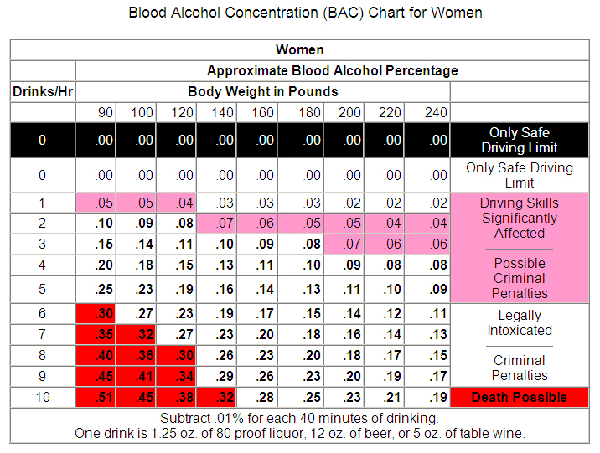
According to the chart, which BAC falls within the safe driving limit?
What is the BAC of a person weighing 100 pounds after consuming 2 drinks?
How many ounces of wine result in a BAC of .05 for a person weighing 180 pounds?

